Slide 1




Light Tree Covers, Routing, and Path-Reporting Oracles via Spanning Tree Covers in Doubling Graphs
Hsien-Chih Chang
Dartmouth College
Jonathan Conroy
Dartmouth College
Hung Le
UMass Amherst
Cuong Than
UMass Amherst
Shay Solomon
Tel Aviv University
Notes:
The focus might be two fold (1) is there a light tree cover? (2) is there a spanning tree cover for any graph family with stretch 1+eps and/or O(1) trees?

Slide 2
Light Tree Covers, Routing, and Path-Reporting Oracles via Spanning Tree Covers in Doubling Graphs
Hsien-Chih Chang
Dartmouth College
Jonathan Conroy
Dartmouth College
Hung Le
UMass Amherst
Cuong Than
UMass Amherst
Shay Solomon
Tel Aviv University
Notes:
The focus might be two fold (1) is there a light tree cover? (2) is there a spanning tree cover for any graph family with stretch 1+eps and/or O(1) trees?

Slide 3
Graph ➔ Tree
Input: graph G = (V, E, w)
Want: Simple representation of shortest-path distance metric
☹ Embedding G into a tree has Ω(n) stretch
Example: Unweighted cycle

Slide 4
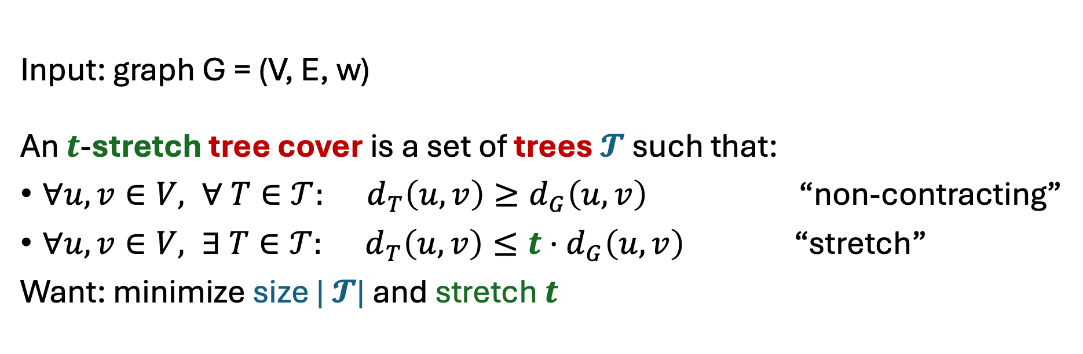
Graph ➔ Tree Tree Cover
Input: graph G = (V, E, w)
An $t$-stretch tree cover is a set of trees $𝓣$ such that:
$∀u,v∈V, ∀ T∈𝒯: d_{T}\left(u,v\right)≥d_{G}\left(u,v\right)$ “non-contracting”
$∀u,v∈V, ∃ T∈𝒯: d_{T}\left(u,v\right)≤t⋅d_{G}\left(u,v\right)$ “stretch”
Want: minimize size | $𝓣$| and stretch $t$
spanning (subgraph of G)
Example: Unweighted cycle
1-stretch tree cover with 2 trees!

Slide 5
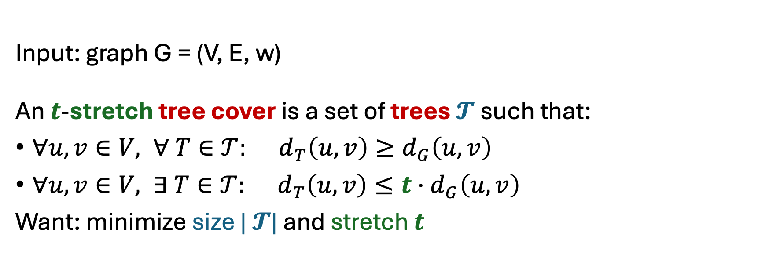
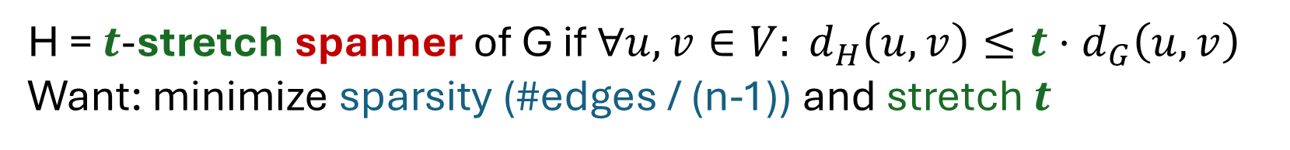
Graph ➔ Tree Tree Cover
Input: graph G = (V, E, w)
An $t$-stretch tree cover is a set of trees $𝓣$ such that:
$∀u,v∈V, ∀ T∈𝒯: d_{T}\left(u,v\right)≥d_{G}\left(u,v\right)$
$∀u,v∈V, ∃ T∈𝒯: d_{T}\left(u,v\right)≤t⋅d_{G}\left(u,v\right)$
Want: minimize size | $𝓣$| and stretch $t$
spanning (subgraph of G)
H = $t$-stretch spanner of G if${∀u,v∈V: d}_{H}\left(u,v\right)≤t⋅d_{G}\left(u,v\right)$
Want: minimize sparsity (#edges / (n-1)) and stretch $t$

Slide 6

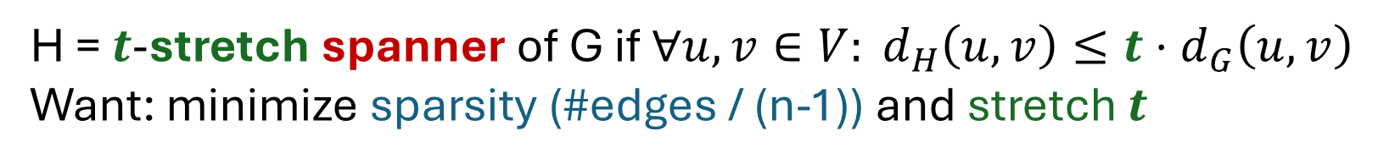
Graph ➔ Tree Tree Cover
Input: graph G = (V, E, w)
An $t$-stretch tree cover is a set of trees $𝓣$ such that:
$∀u,v∈V, ∀ T∈𝒯: d_{T}\left(u,v\right)≥d_{G}\left(u,v\right)$
$∀u,v∈V, ∃ T∈𝒯: d_{T}\left(u,v\right)≤t⋅d_{G}\left(u,v\right)$
Want: minimize size | $𝓣$| and stretch $t$
spanning (subgraph of G)
H = $t$-stretch spanner of G if${∀u,v∈V: d}_{H}\left(u,v\right)≤t⋅d_{G}\left(u,v\right)$
Want: minimize sparsity (#edges / (n-1)) and stretch $t$
Union of trees in $t$-tree cover is a $t$-spanner
Goal: spanner + structural simplicity of trees

Slide 7
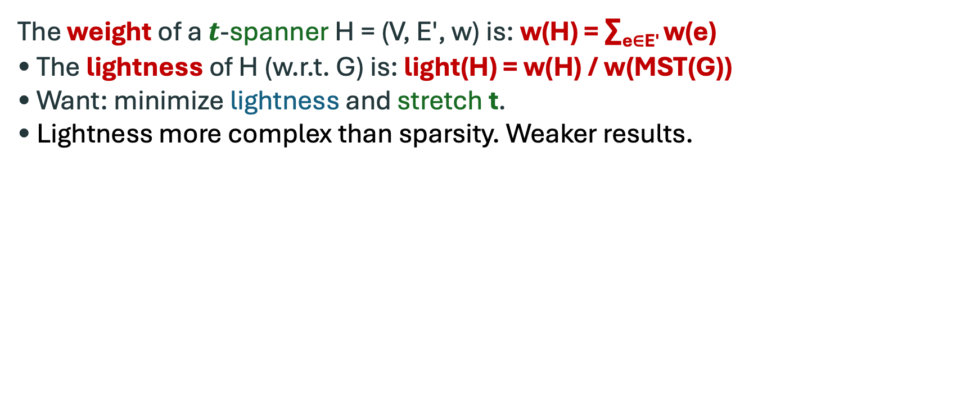
Light-weight Spanners
Sparsity and lightness = main compactness measures
1
3
G
The weight of a $t$-spanner H = (V, E′, w) is: w(H) = ∑_{e∈E′} w(e)
• The lightness of H (w.r.t. G) is: light(H) = w(H) / w(MST(G))
• Want: minimize lightness and stretch t.
• Lightness more complex than sparsity. Weaker results.
3
3
1
1
1
H
1
3
w(MST(G)) = 4
1
1
w(H) = 7
1
Light(H) = 7/4

Slide 8
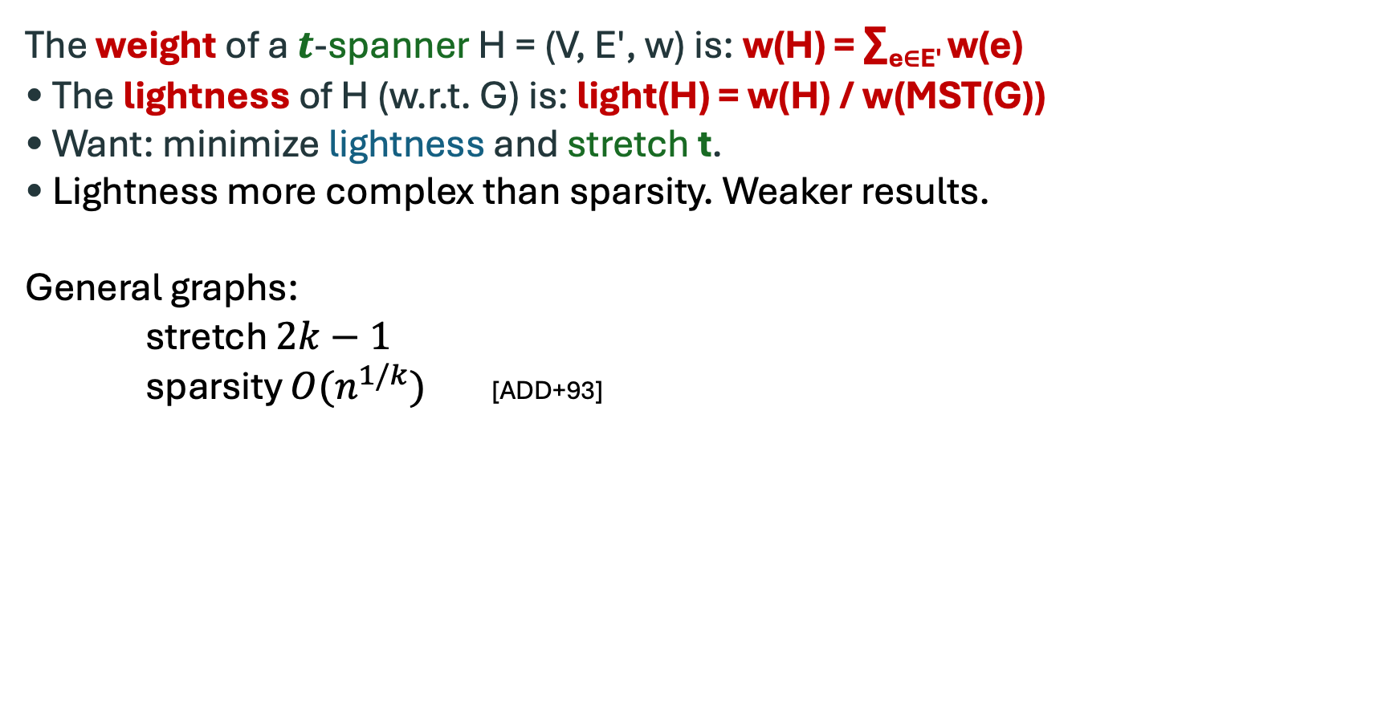
Light-weight Spanners
Sparsity and lightness = main compactness measures
1
3
G
The weight of a $t$-spanner H = (V, E′, w) is: w(H) = ∑_{e∈E′} w(e)
• The lightness of H (w.r.t. G) is: light(H) = w(H) / w(MST(G))
• Want: minimize lightness and stretch t.
• Lightness more complex than sparsity. Weaker results.
General graphs:
stretch $2k−1$
sparsity $O(n^{1/k})$ [ADD+93]
3
3
1
1
1
H
1
3
w(MST(G)) = 4
1
1
w(H) = 7
1
Light(H) = 7/4

Slide 9
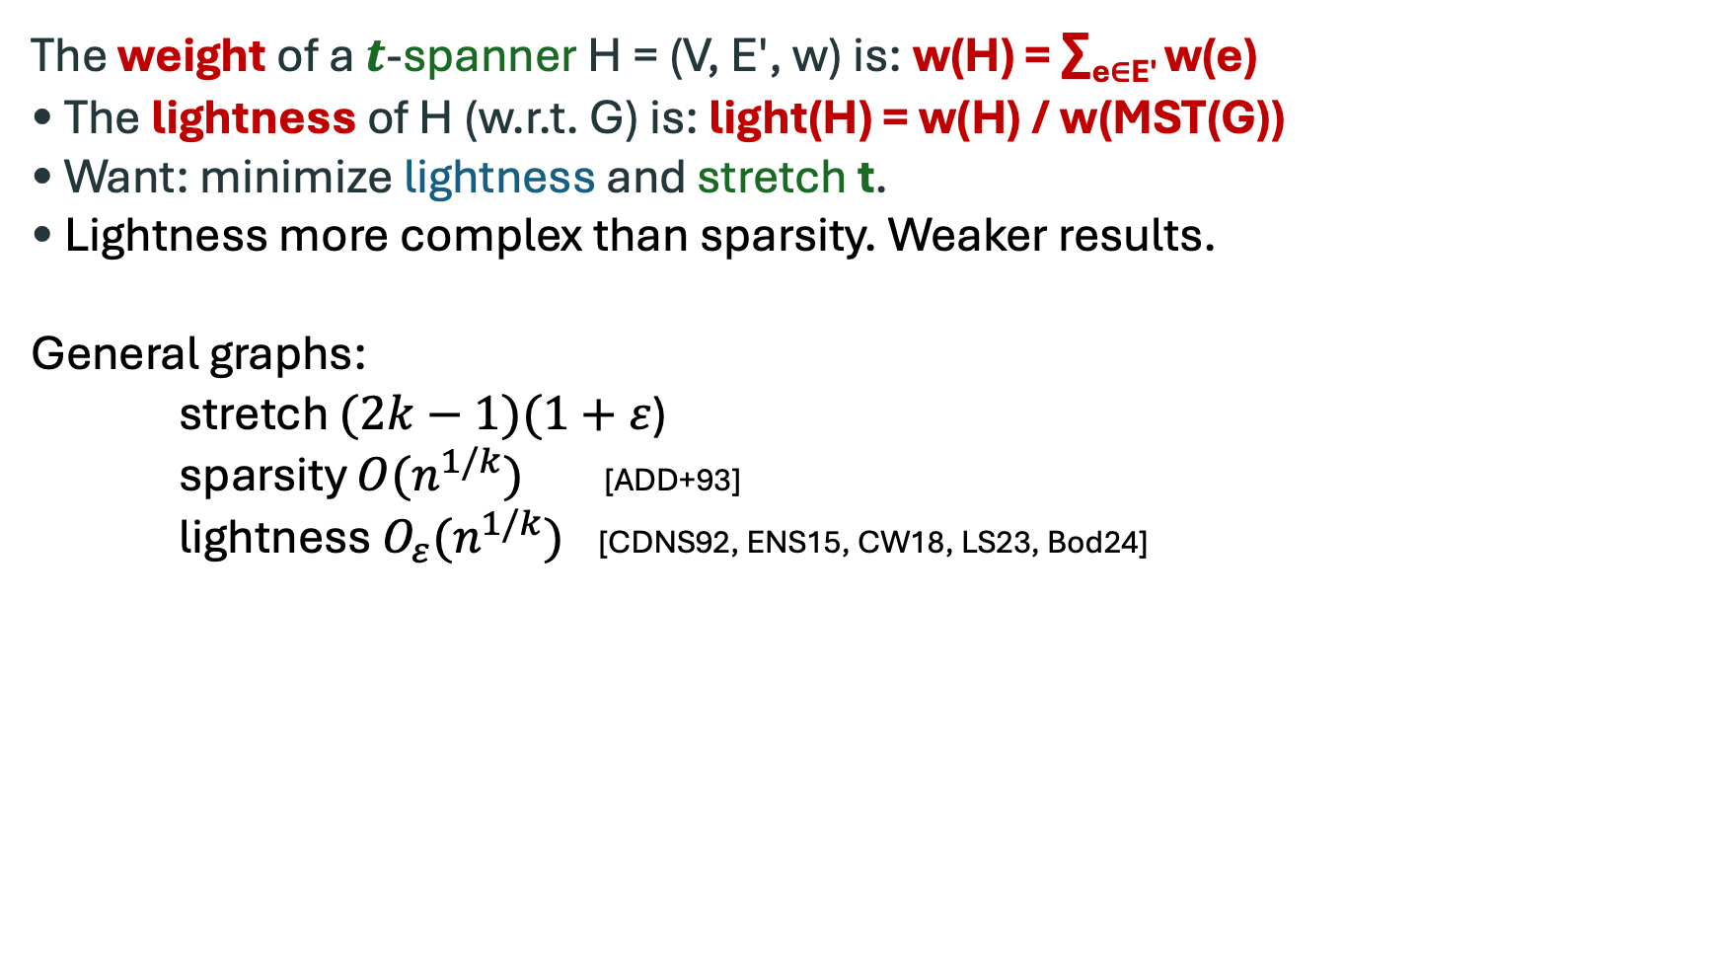
Light-weight Spanners
Sparsity and lightness = main compactness measures
1
3
G
The weight of a $t$-spanner H = (V, E′, w) is: w(H) = ∑_{e∈E′} w(e)
• The lightness of H (w.r.t. G) is: light(H) = w(H) / w(MST(G))
• Want: minimize lightness and stretch t.
• Lightness more complex than sparsity. Weaker results.
General graphs:
stretch $(2k−1)(1+ε$)
sparsity $O(n^{1/k})$ [ADD+93]
lightness $O_{ε}(n^{1/k})$ [CDNS92, ENS15, CW18, LS23, Bod24]
3
3
1
1
1
H
1
3
w(MST(G)) = 4
1
1
w(H) = 7
1
Light(H) = 7/4

Slide 10
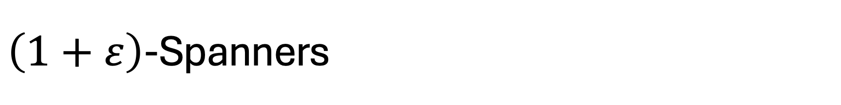
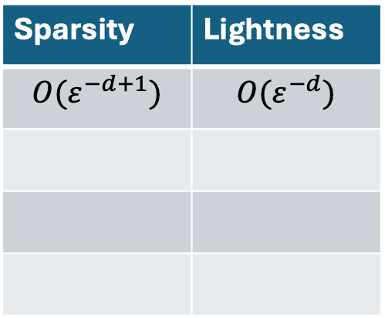
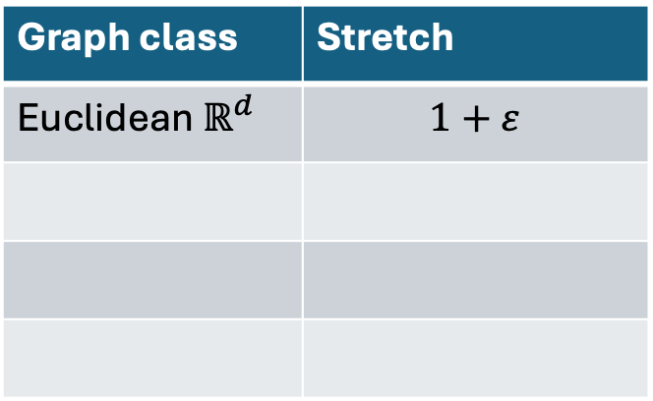
$\left(1+ε\right)$-Spanners
Spanners
Graph class | Stretch
Euclidean$ℝ^{d}$ | $$1+ε$$
Sparsity | Lightness
$$O(ε^{−d+1})$$ | $$O(ε^{−d})$$
[Yao82, Chew86, Clarkson87, …]
[ADD+93, DHN93, DNS95, RS98, NS07, LS19]

Slide 11
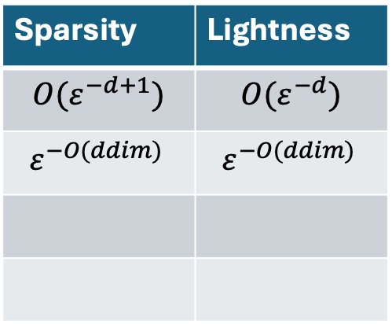
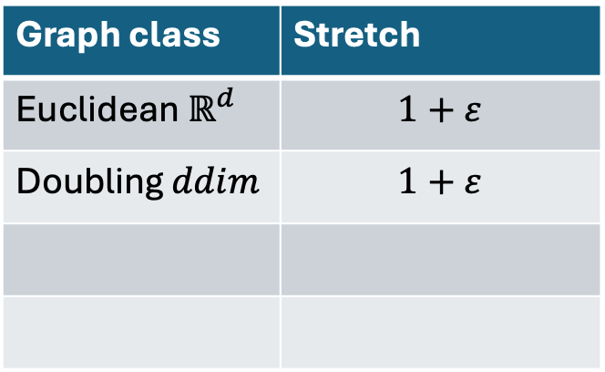
$\left(1+ε\right)$-Spanners
Spanners
Graph class | Stretch
Euclidean$ℝ^{d}$ | $$1+ε$$
Doubling $ddim$ | $$1+ε$$
Sparsity | Lightness
$$O(ε^{−d+1})$$ | $$O(ε^{−d})$$
$$ε^{−O(ddim) }$$ | $$ε^{−O(ddim) }$$
[MN05, BLW19, L20]
Doubling dimension: Metric (X, δ) has doubling dim d if
every ball can be covered by 2^{d} balls of half the radius.
Euclidean space ℝ^{d} has doubling dim Ѳ(d)
2³ boxes to cover
larger 3-dim box

Slide 12
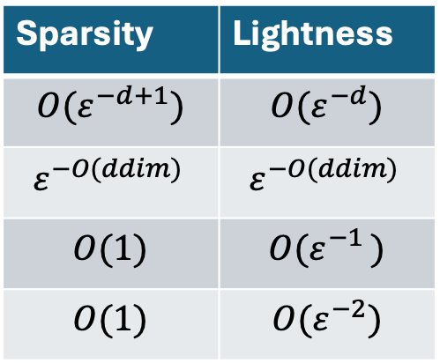
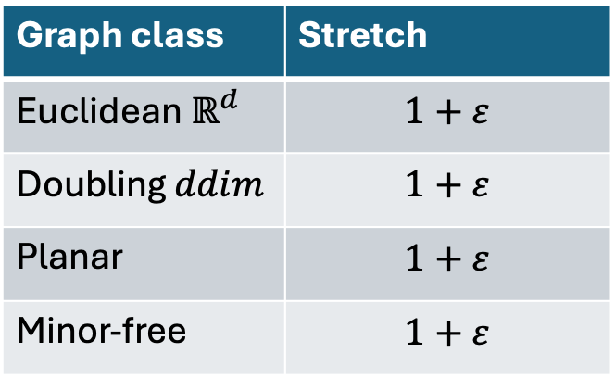
$\left(1+ε\right)$-Spanners
Spanners
Graph class | Stretch
Euclidean$ℝ^{d}$ | $$1+ε$$
Doubling $ddim$ | $$1+ε$$
Planar | $$1+ε$$
Minor-free | $$1+ε$$
Sparsity | Lightness
$$O(ε^{−d+1})$$ | $$O(ε^{−d})$$
$$ε^{−O(ddim) }$$ | $$ε^{−O(ddim) }$$
$$O(1)$$ | $${O(ε}^{−1 })$$
$$O(1)$$ | $${O(ε}^{−2})$$
[ADD+93]
[BLW17,LS23]

Slide 13
Can we transform spanner constructions to tree covers?
Spanners
Graph class | Stretch
Euclidean$ℝ^{d}$ | $$1+ε$$
Doubling $ddim$ | $$1+ε$$
Planar | $$1+ε$$
Minor-free | $$1+ε$$
Sparsity | Lightness
$$O(ε^{−d+1})$$ | $$O(ε^{−d})$$
$$ε^{−O(ddim) }$$ | $$ε^{−O(ddim) }$$
$$O(1)$$ | $${O(ε}^{−1 })$$
$$O(1)$$ | $${O(ε}^{−2})$$

Slide 14
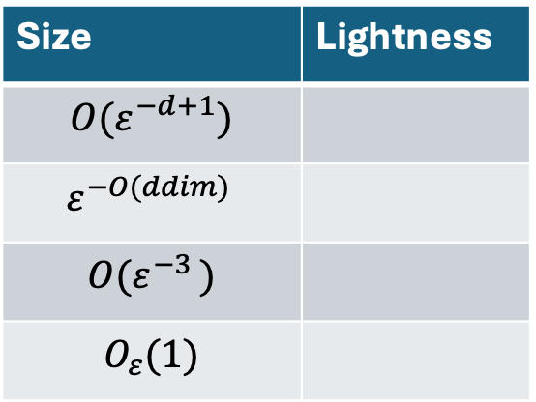
Can we transform spanner constructions to tree covers?
Spanners
Tree cover
Graph class | Stretch
Euclidean$ℝ^{d}$ | $$1+ε$$
Doubling $ddim$ | $$1+ε$$
Planar | $$1+ε$$
Minor-free | $$1+ε$$
Sparsity | Lightness
$$O(ε^{−d+1})$$ | $$O(ε^{−d})$$
$$ε^{−O(ddim) }$$ | $$ε^{−O(ddim) }$$
$$O(1)$$ | $${O(ε}^{−1 })$$
$$O(1)$$ | $${O(ε}^{−2})$$
Size | Lightness
$$O(ε^{−d+1})$$
$$ε^{−O(ddim) }$$
$${O(ε}^{−3 })$$
$$O_{ε}(1)$$
[ADM+95, GKR01, CGMZ05, MN06, ACEFN17, BFN22, CCL+23, CCL+24a, CCL+24b,…]

Slide 15
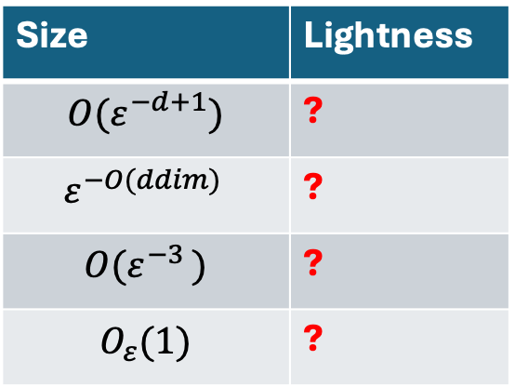
Can we transform spanner constructions to tree covers?
Spanners
Tree cover
Graph class | Stretch
Euclidean$ℝ^{d}$ | $$1+ε$$
Doubling $ddim$ | $$1+ε$$
Planar | $$1+ε$$
Minor-free | $$1+ε$$
Sparsity | Lightness
$$O(ε^{−d+1})$$ | $$O(ε^{−d})$$
$$ε^{−O(ddim) }$$ | $$ε^{−O(ddim) }$$
$$O(1)$$ | $${O(ε}^{−1 })$$
$$O(1)$$ | $${O(ε}^{−2})$$
Size | Lightness
$$O(ε^{−d+1})$$ | ?
$$ε^{−O(ddim) }$$ | ?
$${O(ε}^{−3 })$$ | ?
$$O_{ε}(1)$$ | ?

Slide 16
Can we transform spanner constructions to tree covers?
Spanners
Tree cover
Graph class | Stretch
Euclidean$ℝ^{d}$ | $$1+ε$$
Doubling $ddim$ | $$1+ε$$
Planar | $$1+ε$$
Minor-free | $$1+ε$$
Sparsity | Lightness
$$O(ε^{−d+1})$$ | $$O(ε^{−d})$$
$$ε^{−O(ddim) }$$ | $$ε^{−O(ddim) }$$
$$O(1)$$ | $${O(ε}^{−1 })$$
$$O(1)$$ | $${O(ε}^{−2})$$
Size | Lightness
$$O(ε^{−d+1})$$ | ?
$$ε^{−O(ddim) }$$ | ?
$${O(ε}^{−3 })$$ | ?
$$O_{ε}(1)$$ | ?
Trees are not spanning
(there are Steiner edges)

Slide 17
Can we transform spanner constructions to tree covers?
Spanners
Tree cover
Graph class | Stretch
Euclidean$ℝ^{d}$ | $$1+ε$$
Doubling $ddim$ | $$1+ε$$
Planar | $$1+ε$$
Minor-free | $$1+ε$$
Sparsity | Lightness
$$O(ε^{−d+1})$$ | $$O(ε^{−d})$$
$$ε^{−O(ddim) }$$ | $$ε^{−O(ddim) }$$
$$O(1)$$ | $${O(ε}^{−1 })$$
$$O(1)$$ | $${O(ε}^{−2})$$
Size | Lightness
$$O(ε^{−d+1})$$ | ?
$$ε^{−O(ddim) }$$ | ?
$${O(ε}^{−3 })$$ | ?
$$O_{ε}(1)$$ | ?
Q1: A spanning tree cover with O(1) stretch and #trees?
Q2: A tree cover with O(1) stretch and lightness?
Trees are not spanning
(there are Steiner edges)

Slide 18
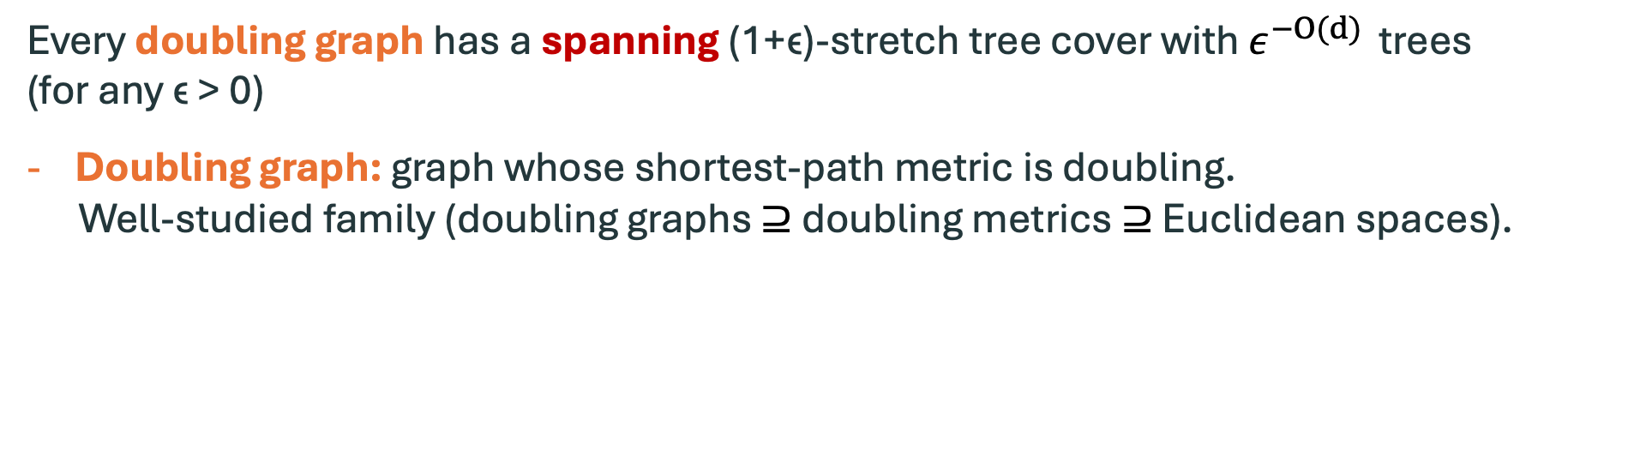
Main Result
Every doubling graph has a spanning (1+ϵ)-stretch tree cover with $ε^{−O(d) }$ trees (for any ϵ > 0)
Doubling graph: graph whose shortest-path metric is doubling.
Well-studied family (doubling graphs $⊇$ doubling metrics $⊇$ Euclidean spaces).

Slide 19
Main Result
Every doubling graph has a spanning (1+ϵ)-stretch tree cover with $ε^{−O(d) }$ trees (for any ϵ > 0)
Doubling graph: graph whose shortest-path metric is doubling.
Well-studied family (doubling graphs $⊇$ doubling metrics $⊇$ Euclidean spaces).
Question 1: Is there a spanning tree cover with O(1) stretch and #trees?
YES (for doubling graphs)
Question 2: Is there a tree cover with small stretch and lightness?
YES (e.g. for ℝ^{d} : apply spanning tree cover on light spanner)

Slide 20
Applications
A compact (1+ϵ)-stretch routing scheme in the fixed-port labeled model
for doubling graphs
* uses optimal (up to dependencies on ϵ and d) bound of O_{ϵ,d}(log n) bits
on all measures (label, header, and routing tables sizes)
* improving O_{ϵ,d}(log(Φ)·log n) [CGMZ05, Slivkins05, AGGM06] Φ = aspect ratio
improving O_{ϵ,d}(log³ n) [AGGM06, KRX07]

Slide 21
Applications
A compact (1+ϵ)-stretch routing scheme in the fixed-port labeled model
for doubling graphs
* uses optimal (up to dependencies on ϵ and d) bound of O_{ϵ,d}(log n) bits
on all measures (label, header, and routing tables sizes)
* improving O_{ϵ,d}(log(Φ)·log n) [CGMZ05, Slivkins05, AGGM06] Φ = aspect ratio
improving O_{ϵ,d}(log³ n) [AGGM06, KRX07]
1st path-reporting distance oracle for doubling graphs
achieving optimal bounds for all important parameters:
O_{ϵ,d}(n) space, (1+ϵ)-stretch, and O_{ϵ,d}(1) query time

Slide 22


Slide 23
Framework
Suppose we have a “nice” (bounded strong diameter) hierarchical partition:
Build a spanning tree on each node (cluster)
Connect all trees (how?)
In practice we need a family of hierarchical partitions (with appropriate padding etc.)

Slide 24
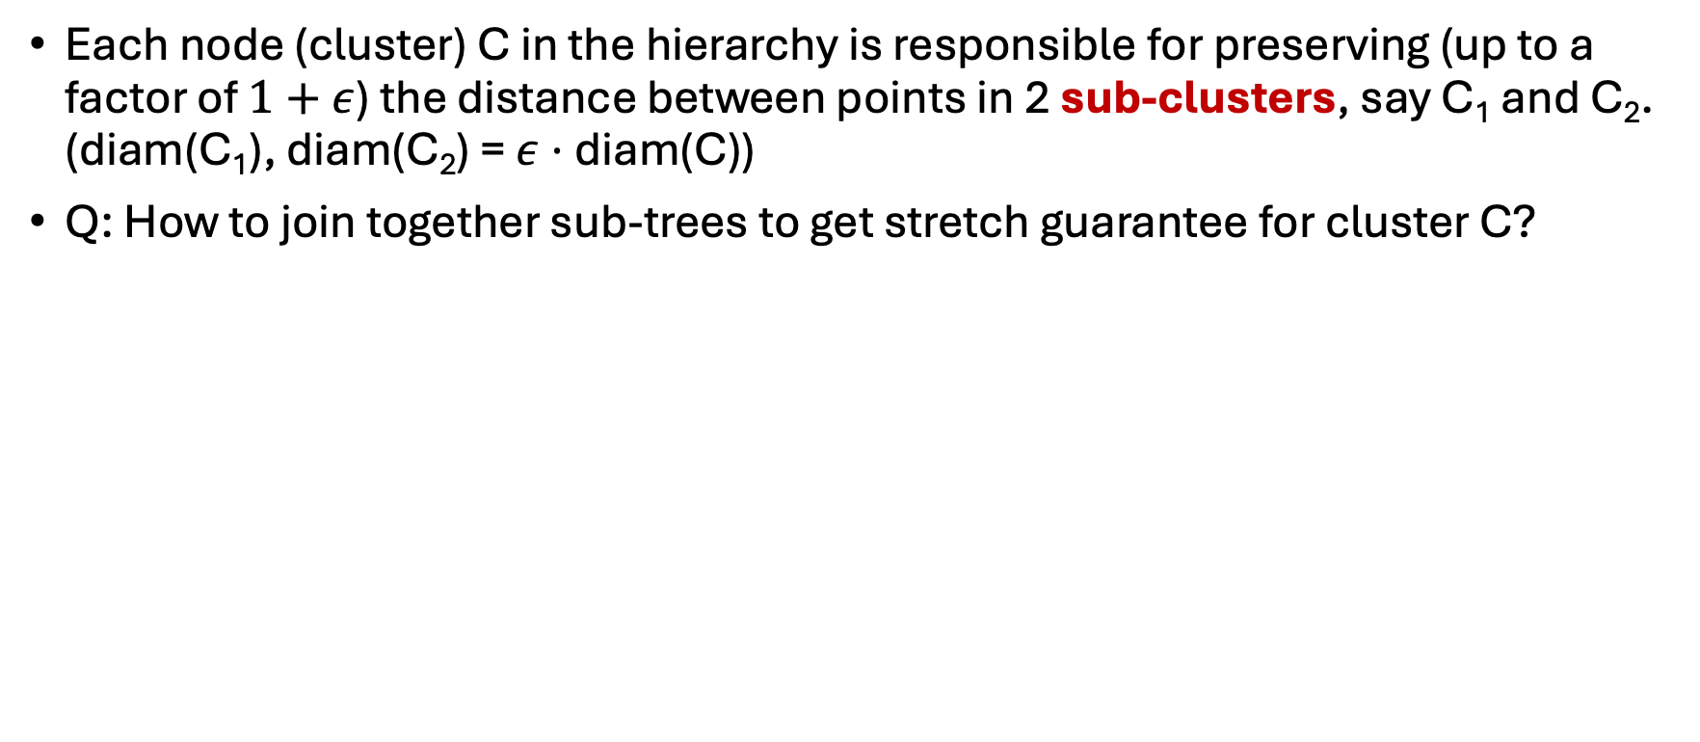
Main Challenge
Each node (cluster) C in the hierarchy is responsible for preserving (up to a factor of $1+ε$) the distance between points in 2 sub-clusters, say C₁ and C₂. (diam(C₁), diam(C₂) = $ε⋅$diam(C))
Q: How to join together sub-trees to get stretch guarantee for cluster C?
C₁
C
C₂

Slide 25
Key Tool: Preservable Set
Each node (cluster) C in the hierarchy is responsible for preserving (up to a factor of $1+ε$) the distance between points in 2 sub-clusters, say C₁ and C₂. (diam(C₁), diam(C₂) = $ε⋅$diam(C))
Q: How to join together sub-trees to get stretch guarantee for cluster C?
C₁
Key idea: For each sub-cluster,
inductively guarantee that
the blue path appears in its tree
C
C₂

Slide 26
Key Tool: Preservable Set
Each node (cluster) C in the hierarchy is responsible for preserving (up to a factor of $1+ε$) the distance between points in 2 sub-clusters, say C₁ and C₂. (diam(C₁), diam(C₂) = $ε⋅$diam(C))
Q: How to join together sub-trees to get stretch guarantee for cluster C?
C₁
Key idea: For each sub-cluster,
inductively guarantee that
the blue path appears in its tree
C
C₂

Slide 27
Key Tool: Preservable Set
Each node (cluster) C in the hierarchy is responsible for preserving (up to a factor of $1+ε$) the distance between points in 2 sub-clusters, say C₁ and C₂. (diam(C₁), diam(C₂) = $ε⋅$diam(C))
Q: How to join together sub-trees to get stretch guarantee for cluster C?
C₁
Key idea: For each sub-cluster,
inductively guarantee that
the blue path appears in its tree
C
C₂

Slide 28
Key Tool: Preservable Set
Each node (cluster) C in the hierarchy is responsible for preserving (up to a factor of $1+ε$) the distance between points in 2 sub-clusters, say C₁ and C₂. (diam(C₁), diam(C₂) = $ε⋅$diam(C))
Q: How to join together sub-trees to get stretch guarantee for cluster C?
C₁
Key idea: For each sub-cluster,
inductively guarantee that
the blue path appears in its tree
C
C₂

Slide 29
Key Tool: Preservable Set
Each node (cluster) C in the hierarchy is responsible for preserving (up to a factor of $1+ε$) the distance between points in 2 sub-clusters, say C₁ and C₂. (diam(C₁), diam(C₂) = $ε⋅$diam(C))
Q: How to join together sub-trees to get stretch guarantee for cluster C?
C₁
Key idea: For each sub-cluster,
inductively guarantee that
the blue path appears in its tree
C
C₂

Slide 30
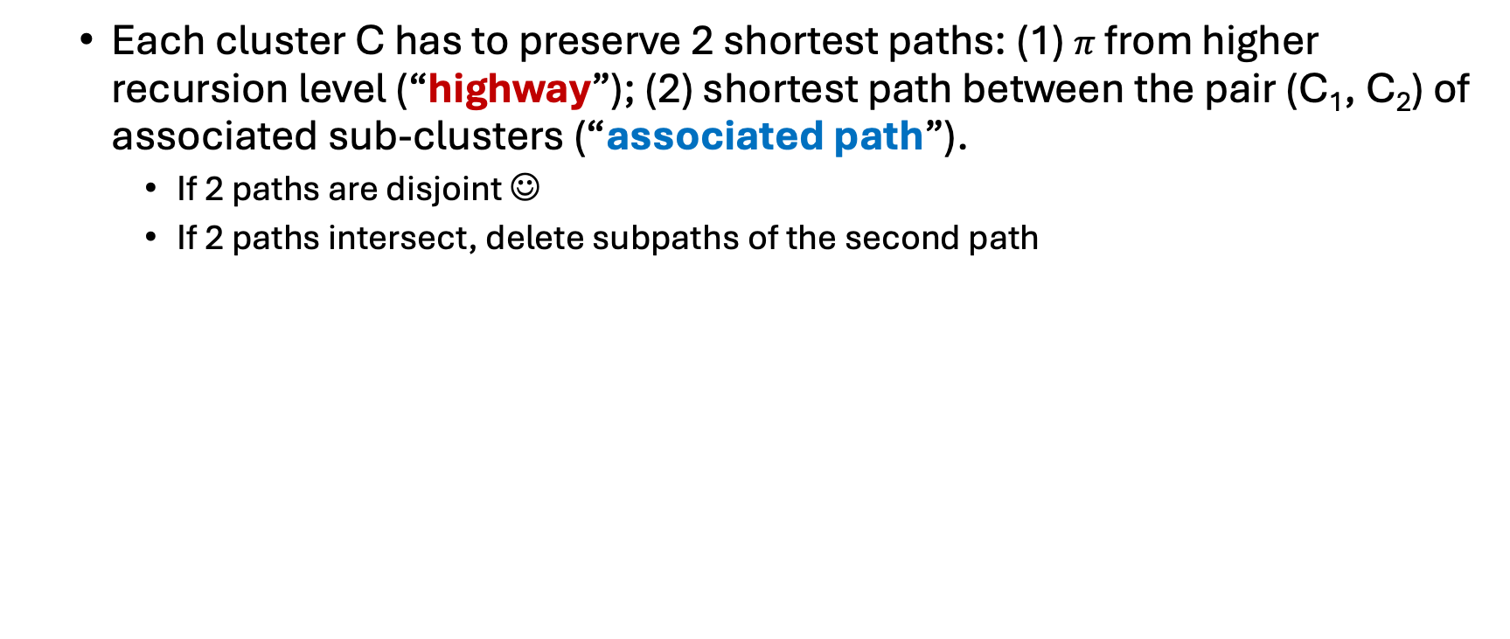
Key Tool: Preservable Set
Each cluster C has to preserve 2 shortest paths: (1) $π$from higher recursion level (“highway”); (2) shortest path between the pair (C₁, C₂) of associated sub-clusters (“associated path”).
If 2 paths are disjoint ☺
If 2 paths intersect, delete subpaths of the second path
$$π$$
C₁
Want: Every sub-cluster hit by 1 path
C
C₂

Slide 31
Summary
1st spanning tree cover with constant stretch and #trees for any graph family
1st tree cover with constant stretch and lightness for any graph/metric family
Applicable
New techniques (strong diam HPF, preservable set)

Slide 32
Summary
1st spanning tree cover with constant stretch and #trees for any graph family
1st tree cover with constant stretch and lightness for any graph/metric family
Applicable
New techniques (strong diam HPF, preservable set)
Spanning tree cover for planar graphs? For other graph families?
* Weaker version: Light tree cover for planar metrics / other metrics?
Any lower bound?
Open Problems

Slide 33
Summary
1st spanning tree cover with constant stretch and #trees for any graph family
1st tree cover with constant stretch and lightness for any graph/metric family
Applicable
New techniques (strong diam HPF, preservable set)
Spanning tree cover for planar graphs? For other graph families?
* Weaker version: Light tree cover for planar metrics / other metrics?
Any lower bound?
Thank you!
Open Problems

